Slide 1


Benchmarking feature selection algorithms in the molecular property prediction space
Group 2
Alejandro Corrochano
Azadeh Karimisefat
Dipti Aswal
Yossra Gharbi

Slide 2
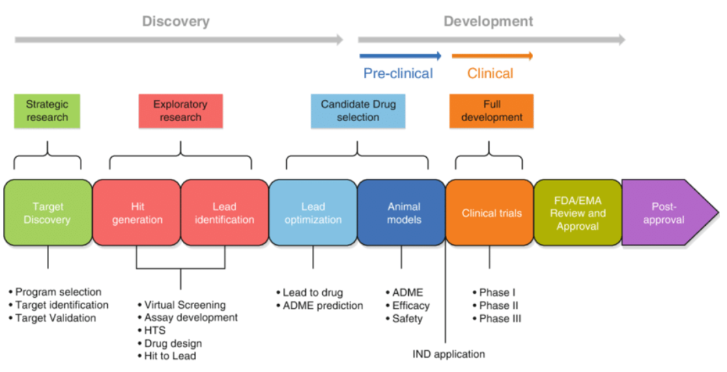
Early drug discovery process
Drug discovery pipeline
Image Reference: https://www.researchgate.net/publication/335215729_Medicinal_Biotechnology_for_Disease_Modeling_Clinical_Therapy_and_Drug_Discovery_and_Development

Slide 3
Early drug discovery process
Our Project
Image Reference: https://www.researchgate.net/publication/335215729_Medicinal_Biotechnology_for_Disease_Modeling_Clinical_Therapy_and_Drug_Discovery_and_Development

Slide 4
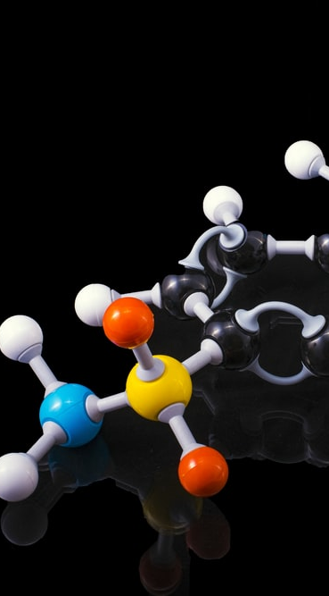

Why are data science techniques being applied in the industry?
$${10}^{60}$$
Incredibly vast : Nearly molecules in chemical space
Computational Methods
ML algorithms : Increase in research in pharmaceutical companies in recent years.

Slide 5
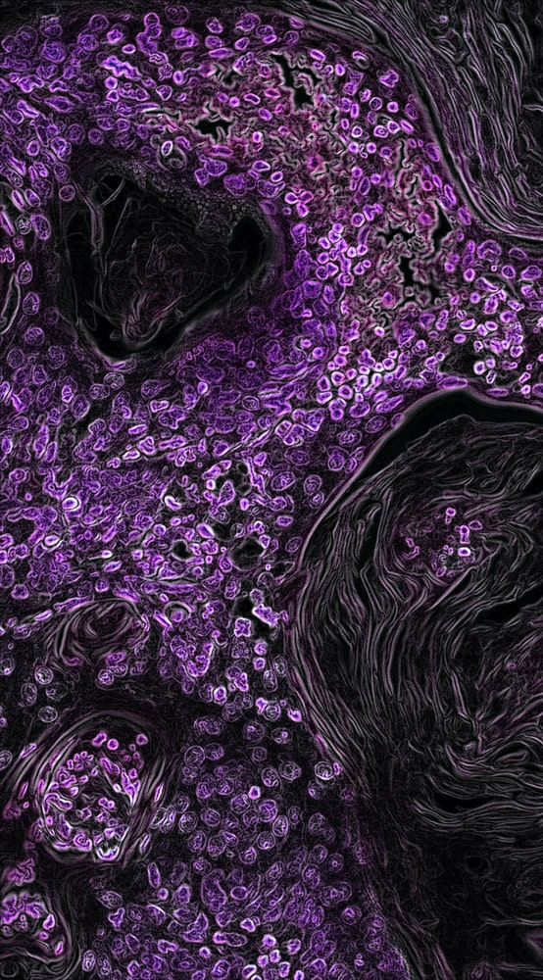
Project goal
“To evaluate variety of machine learning models to better predict lipophilicity and Ames Mutagenicity properties of unseen compounds by benchmarking several feature selection techniques.”
Notes:
So now that we have discovered the impact that data science have within the pharma industry, we can better understand the underlying motivation of our project, which is to evaluate different ml models to better predict X1 and X2. By benchmarking several feature selection algorithms we can better predict these two properties on unseen compounds. And that might help us improving predictions on unseen compounds

Slide 6
Workflow
Notes:
This is the workflow we are following. We first wanted to do a lot of reading to get familiar with the concepts related to the project. Once we felt we had enough knowledge about the topic, we started playing with the data and to transform it in a way we could work with for our prediction tasks. Then, we build a few baseline models to get some insights about the metrics we would obtain if nothing is modified. Afterwards we apply feature selection techniques to identify the most relevant features, we tune hyperparameters based on performance against validation set, and evaluate those to decide whether repeating the loop or deploying it.

Slide 7
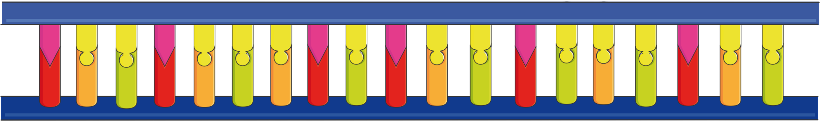
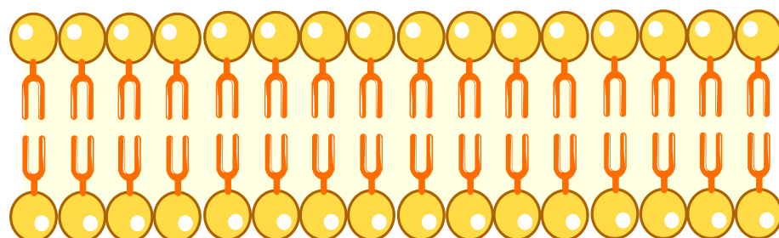
ADMET properties
Drugs travel from the site of administration (e.g., oral) to their target sites ( before they decompose, escape, and become inert in the body)
For being safe and efficacious: should have Absorption, Distribution, Metabolism, Excretion and Toxicity (ADMET) properties.
AMES Mutagenicity
Lipophilicity
The ability of a drug to dissolve in a lipid environment.
High lipophilicity : High rate of metabolism
Poor solubility : High turn-over and low absorption.
The ability of a drug to induce genetic alterations.
Damage to the DNA : Cell death or Cancer
Notes:
Now is time to explain the things we are trying to predict. Both ames and lipophilicity are ADME properties, which describe the behaviour of compounds in terms of absorption, distribution, metabolism, and excretion. These properties give us a clue about how the drug interacts with our organism. AMES is the ability of the drug to produce genetic alterations, and lipophilcity, the drugs ability to dissolve in a lipid, hence being able to get through the cell membrane. Taking this into consideration, we want a drug to not induce genetic alterations and to find a balance between lipophilicity and absorption, since they are mutually exclusive.

Slide 8

Dataset
Property | Number of data points | ML task
Solubility | 9982 | Regression
hERG | 648 | Binary classification
Lipophilicity | 4200 | Regression
AMES mutagenicity | 7255 | Binary classification
Therapeutics Data Commons (TDC) is an open-science platform with AI/ML-ready datasets and learning tasks for therapeutics, spanning the discovery and development of safe and effective medicines.*
Group 2
* https://tdcommons.ai/
Notes:
Data regarding these two properties can be found in the therapeutics data commons website, where several datasets related to the field can be found. Now, Yossra will explain how to obtain the desired features within each of these two datasets. I will now hand over to Yossra so she can explain how to work with this.

Slide 9
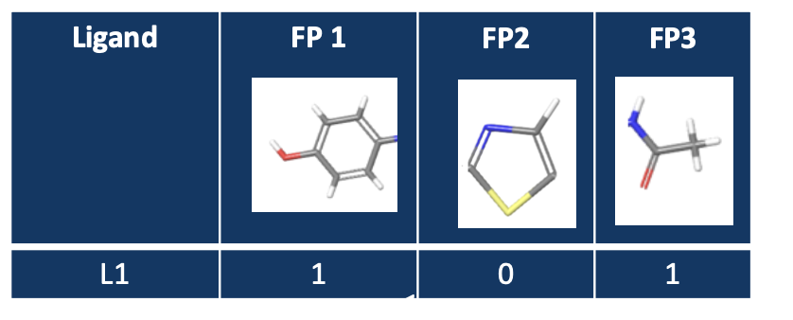
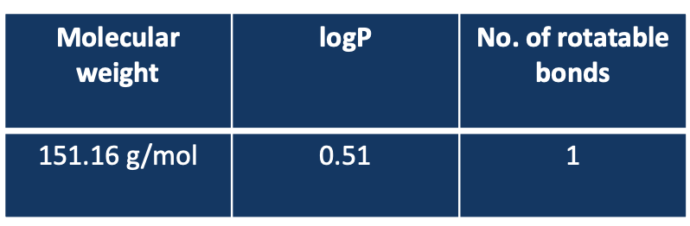
Descriptors and molecular fingerprints
Descriptors: Mathematical representations of molecular properties generated by algorithms
1D descriptors are calculated from the molecular formula of the molecule
2D descriptors are more complex and represent molecular information regarding the size, shape, and electronic distribution in the molecule.
The 3D descriptors describe properties that are related to the 3D structure of the molecule.
Quantitatively describe the physical and chemical information of the molecules
Molecular fingerprints: Representations of chemical structures
Used for similarity searching, clustering, and classification
tables taken from Vigneshwari Subramanian and Anton Martinsson AstraZeneca’s presentation

Slide 10

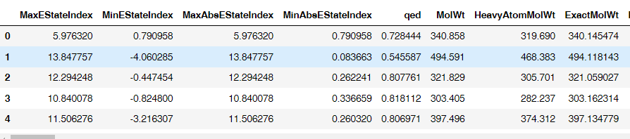
Descriptors | RDKit
RDKit package:
For descriptors: rdkit.Chem
For calculating descriptors: rdkit.ML.Descriptors.MoleculeDescriptors
Class: MolecularDescriptorCalculator
gets the list of descriptors and calculates those list for each molecule.
208 descriptors for each molecule.

Slide 11
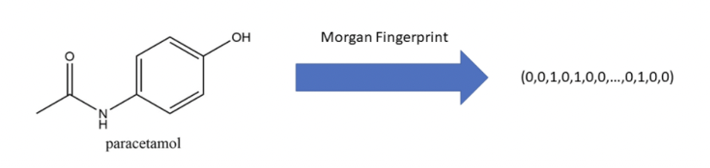
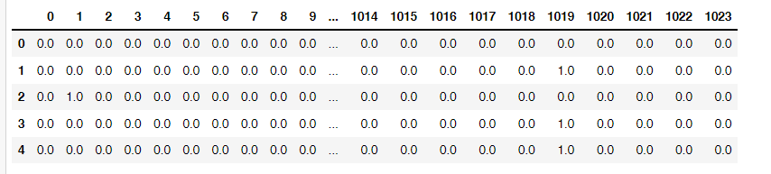
Fingerprints | RDKit
RDKit package:
For fingerprints: rdkit.AllChem
For calculating fingerprints: AllChem.GetMorganFingerprintAsBitVect()
Converts the molecular fingerprints into a binary array
1024 fingerprints for each molecule

Slide 12
Pre-processing
Pre-processing is an essential step in our quest to obtain the most accurate models. Below can be seen the main guideline defined.
1
Remove duplicated compounds and non-desired fragments.
Standardize molecules with help of standardize_smiles library from molvs
Dropping the rows with NaN values
Splitting data into 3 different sets: Training, validation, and test.
Generating a normalized versión for linear models
2
Pipeline
3
4
5

Slide 13

Baseline Modelling
Choose descriptor sets using:
Molecular Descriptors only
Fingerprints only
Both Molecular Descriptors and fingerprints
Algorithms
Random Forest, XGBoost, Support Vector Machines (Regression)
Random Forest, Logistic Regression, KNN, Support Vector Machines (Classification)
Perform hyperparameter optimisation using RandomSearchCV
Create Baseline model using above descriptor sets and modelling techniques

Slide 14

Results | Lipophilicity
In order to develop the best model for the regression task, we conducted several approaches that include the following:
Baseline computation
Manual data cleaning
Minimum-Redundancy-Maximum-Relevance (MRMR)
RelieFf
Mutual info regression/classification (MIR/MIC)

Slide 15
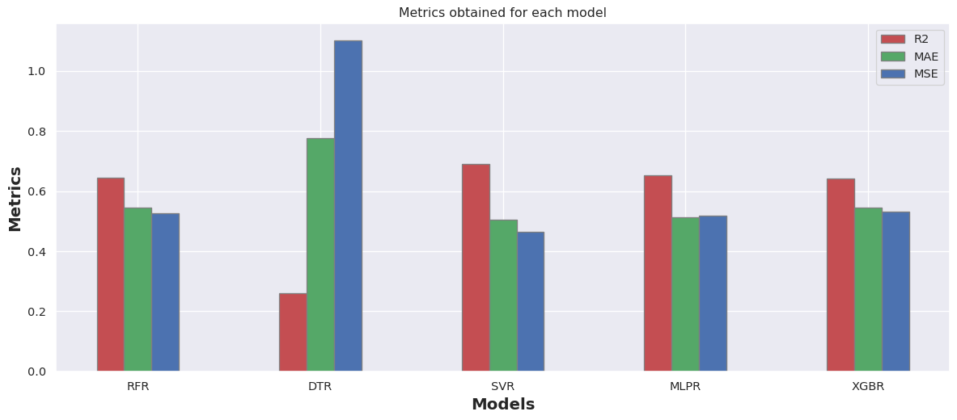
Results | Baseline for Lipophilicity
All descriptors are fed into the model and with feature selection or hyperparameter tuning algorithm
Model with best metrics is SVR
RFR | R2: 0.646, MAE: 0.546, MSE: 0.527
DTR | R2: 0.260, MAE: 0.775, MSE: 1.102
SVR | R2: 0.689, MAE: 0.503, MSE: 0.463
MLPR | R2: 0.652, MAE: 0.514, MSE: 0.517
XGBR | R2: 0.643, MAE: 0.545, MSE: 0.531

Slide 16
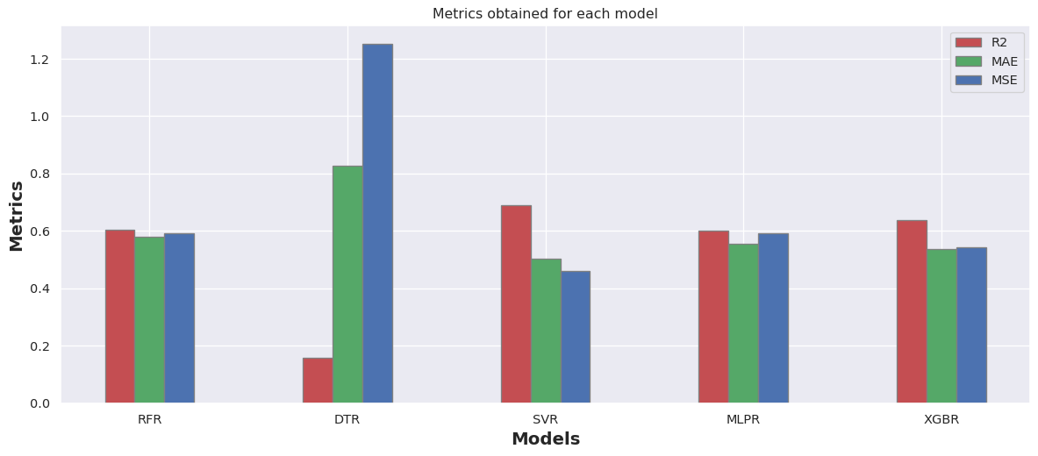
Results | Manual data cleaning for Lipophilicity
Removal of features that may produce more noise than desired. To do this, we delete descriptors with zero variance, and highly correlated against other non-target features.
Model with best R2 score has
159 features
RFR | R2: 0.600, MAE: 0.581, MSE: 0.595
DTR | R2: 0.213, MAE: 0.806, MSE: 1.171
SVR | R2: 0.690, MAE: 0.502, MSE: 0.462
MLPR | R2: 0.625, MAE: 0.521, MSE: 0.558
XGBR | R2: 0.639, MAE: 0.533, MSE: 0.537
Data cleaning process
MolLogP and BCUT2D features
Zero variance features
Metrics post hyper parameter optimization
High correlated features
SVR | R2: 0.743, MAE: 0.447, MSE: 0.382

Slide 17
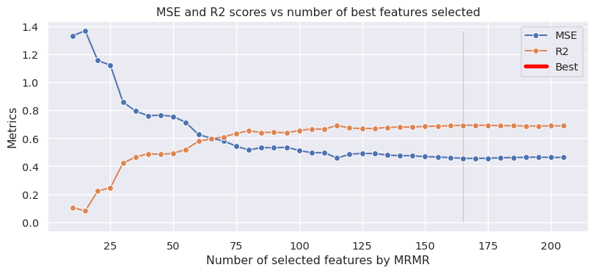
Results | MRMR in Lipophilicity
Algorithm seeks to find a set of features giving the best possible predictive performance specifically, based on the reasonable trade-off between relevance and redundancy.
Model with best R2 score has
165 features
RFR | R2: 0.640, MAE: 0.552, MSE: 0.536
DTR | R2: 0.199, MAE: 0.799, MSE: 1.193
SVR | R2: 0.694, MAE: 0.502, MSE: 0.456
MLPR | R2: 0.616, MAE: 0.545, MSE: 0.571
XGBR | R2: 0.662, MAE: 0.531, MSE: 0.503
R2 scores/Model with less features
XGBR | 50 features: 0.492
XGBR | 65 features: 0.596
XGBR | 80 features: 0.653
Metrics post hyper parameter optimization
SVR | R2: 0.748, MAE: 0.447, MSE: 0.374

Slide 18
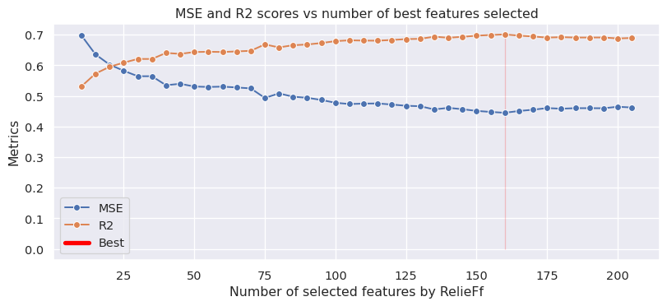
Results | RELIEFF in Lipophilicity
This method assumes the dependencies between features and tries to estimate the quality of attributes based on how well the attribute can distinguish between instances that are near to each other.
Model with best R2 score has
165 features
RFR | R2: 0.647, MAE: 0.548, MSE: 0.526
DTR | R2: 0.204, MAE: 0.800, MSE: 1.185
SVR | R2: 0.701, MAE: 0.492, MSE: 0.445
MLPR | R2: 0.679, MAE: 0.517, MSE: 0.478
XGBR | R2: 0.670, MAE: 0.521, MSE: 0.491
R2 scores/Model with less features
SVR | 30 features: 0.621
SVR | 60 features: 0.644
SVR | 90 features: 0.668
Metrics post hyper parameter optimization
SVR | R2: 0.753, MAE: 0.446, MSE: 0.367

Slide 19
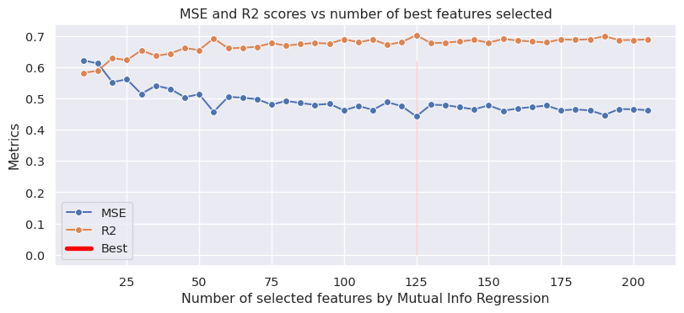
Results | MIR in Lipophilicity
It measures Mutual Information Regression between a matrix containing a set of feature vectors and the target. Explains how much information about the target the variable will be obtained by having observed a feature.
Model with best R2 score has
125 features
RFR | R2: 0.643, MAE: 0.546, MSE: 0.532
DTR | R2: 0.243, MAE: 0.755, MSE: 1.127
SVR | R2: 0.690, MAE: 0.508, MSE: 0.462
MLPR | R2: 0.639, MAE: 0.547, MSE: 0.537
XGBR | R2: 0.650, MAE: 0.544, MSE: 0.521
R2 scores/Model with less features
SVR | 30 features: 0.642
SVR | 60 features: 0.661
SVR | 90 features: 0.678
Metrics post hyper parameter optimization
SVR | R2: 0.737, MAE: 0.462, MSE: 0.391

Slide 20
Results | Fingerprints in Lipophilicity
We also tried to predict lipophilicity by just using the fingerprints.
Model with best metrics is SVR
LR | R2: 0.38, MAE: 0.72, MSE: 0.92
RFR | R2: 0.50, MAE: 0.66, MSE: 0.74
DTR | R2: 0.05, MAE: 0.86, MSE: 1.42
SVR | R2: 0.56, MAE: 0.63, MSE: 0.66
MLPR | R2: 0.54, MAE: 0.61, MSE: 0.69

Slide 21
Results | Lipophilicity
In order to come up with the best model, we tested several configurations that lead us to different results.
Metric used (SVR) | Baseline | MRMR feature selection | Post hyper-parameter tuning (MRMR) | RelieFf Feature selection | Post hyper-parameter tuning (RelieFf) | Mutual Info Regression Feature selection | Post hyper-parameter tuning (MIR)
# of fts | 207 | 165 | 165 | 160 | 160 | 125 | 125
R2 | 0.689 | 0.694 | 0.748 | 0.701 | 0.753 | 0.684 | 0.737
MSE | 0.463 | 0.456 | 0.374 | 0.445 | 0.367 | 0.471 | 0.391
Metric used (SVR) | Post manual cleaning | Post Hyper-parameter optimization (PMC) | Fingerprints
R2 | 0.690 | 0.743 | 0.56
MSE | 0.462 | 0.382 | 0.66

Slide 22
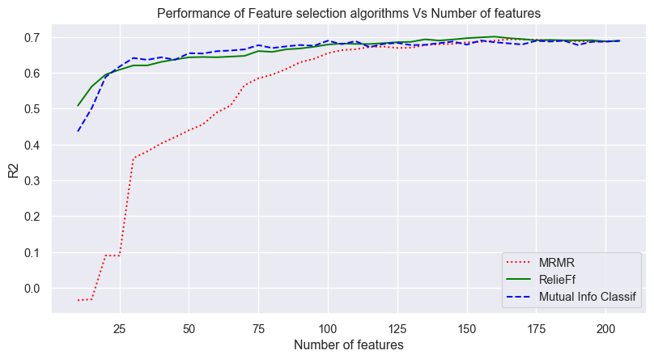
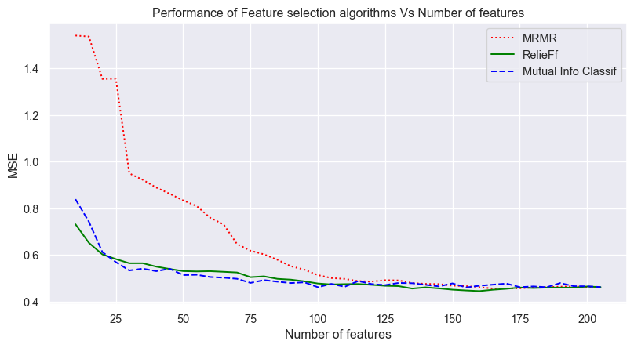
Results | Feature selection performance
Comparative performance of the R2 and MSE scores for all the selected Feature selection algorithms.
Based on these results, we can conclude that the model that better performs is the SVR one with RelieFf selected features and tuned hyperparameters

Slide 23
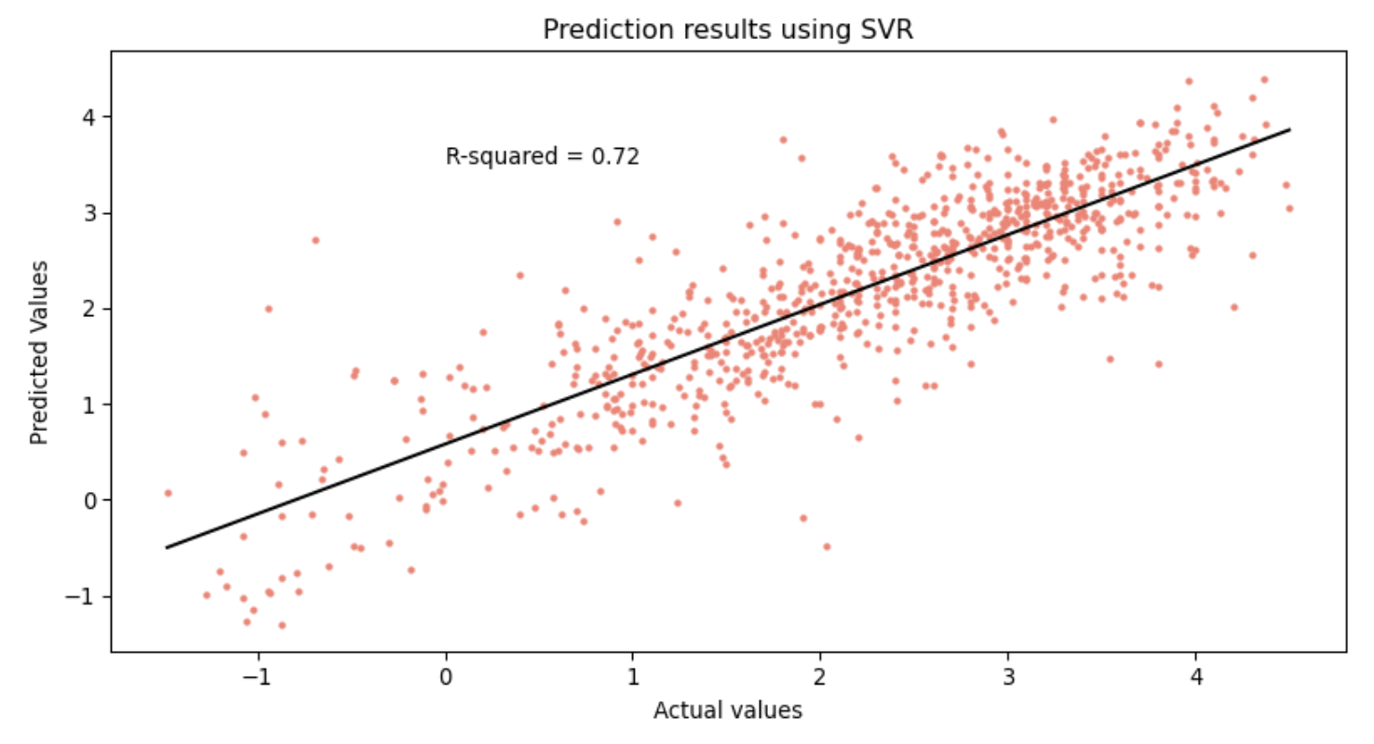
Results | Performance in test set
Now we’ve got the model, we check its performance against the test dataset.
Number of samples: 840
Metric | R2 | MSE | MAE
Score | 0.722 | 0.460 | 0.400

Slide 24

Results | Ames Mutagenicity
In order to develop the best model for the classification task, we conducted several approaches that include the following:
Baseline computation
Manual data cleaning
Minimum-Redundancy-Maximum-Relevance (MRMR)
RelieFf
Mutual info regression/classification (MIR/MIC)

Slide 25
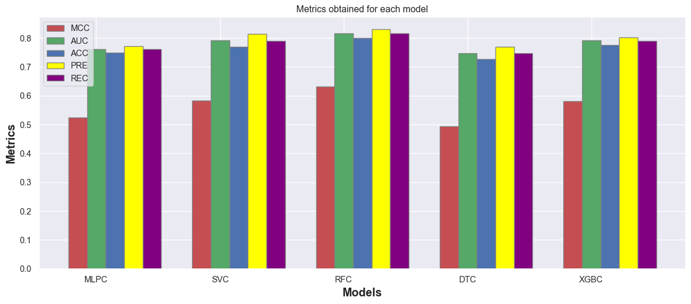
Results | Baseline for Ames Mutagenicity
All descriptors are imputed into the model and no feature selection or hyperparameter tuning algorithm is applied.
MLPC | MCC: 0.524, AUC: 0.762, Accuracy: 0.749, Precision: 0.772, Recall: 0.762 SVC | MCC: 0.583, AUC: 0.791, Accuracy: 0.771, Precision: 0.814, Recall: 0.791
RFC | MCC: 0.632, AUC: 0.816, Accuracy: 0.799, Precision: 0.831, Recall: 0.816
DTC | MCC: 0.495, AUC: 0.747, Accuracy: 0.728, Precision: 0.769, Recall: 0.747
XGBC | MCC: 0.582, AUC: 0.791, Accuracy: 0.777, Precision: 0.803, Recall: 0.791
Model with best metrics is
RFC

Slide 26
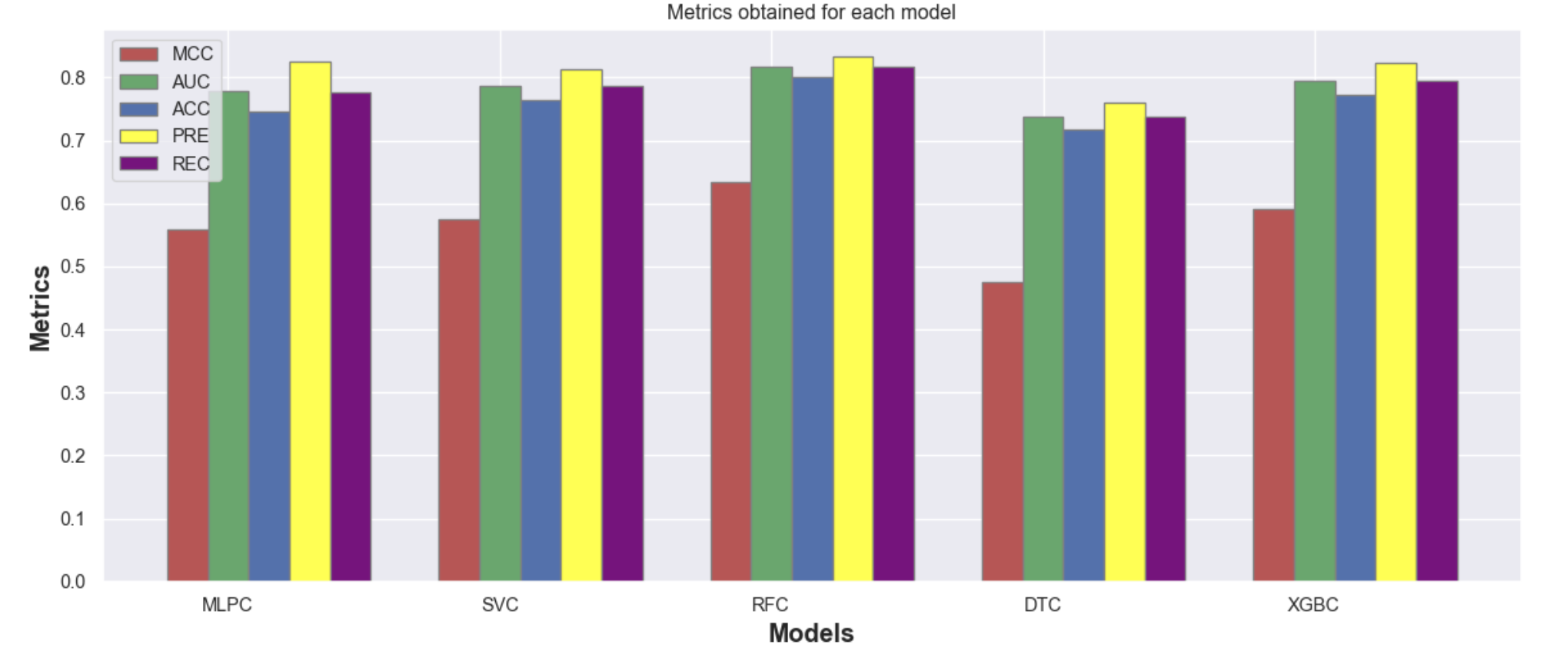
Results | Manual data cleaning for Lipophilicity
Removal of features that may produce more noise than desired. To do this, we delete descriptors with zero variance, and highly correlated against other non-target features.
Model with best R2 score has
163 features
MLPC | MCC: 0.558, AUC: 0.778, Precision: 0.746, Recall: 0.825, Accuracy: 0.777
SVC | MCC: 0.575, AUC: 0.787, Precision: 0.765, Recall: 0.814, Accuracy: 0.787
RFC | MCC: 0.635, AUC: 0.817, Precision: 0.800, Recall: 0.834, Accuracy: 0.817
DTC | MCC: 0.476, AUC: 0.738, Precision: 0.718, Recall: 0.761, Accuracy: 0.737
XGBC | MCC: 0.592, AUC: 0.796, Precision: 0.772, Recall: 0.823, Accuracy: 0.795
Data cleaning process
Metrics post hyper parameter optimization
RFC| MCC: 0.652, AUC: 0.826, Prec: 0.802 , Recall: 0.854 , Acc: 0.825

Slide 27
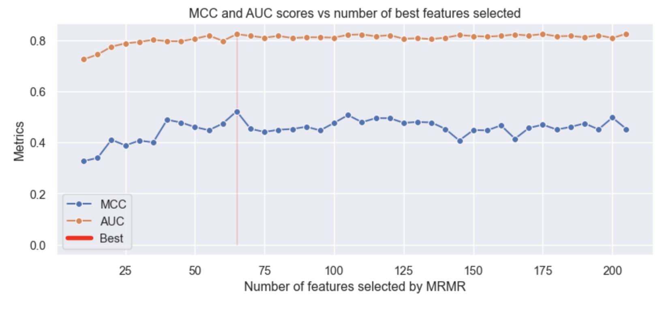
Results | MRMR in Ames
Algorithm seeks to find a set of features giving the best possible predictive performance specifically, based on the reasonable trade-off between relevance and redundancy.
Model with best metrics has
65 features
MLPC | MCC: 0.537, AUC: 0.769, Precision: 0.769, Recall: 0.752, Accuracy: 0.769
SVC | MCC: 0.522, AUC: 0.760, Precision: 0.730, Recall: 0.806, Accuracy: 0.759
RFC | MCC: 0.648, AUC: 0.824, Precision: 0.813, Recall: 0.831, Accuracy: 0.824
DTC | MCC: 0.527, AUC: 0.763, Precision: 0.753, Recall: 0.766, Accuracy: 0.763
XGBC | MCC: 0.618, AUC: 0.809, Precision: 0.790, Recall: 0.828, Accuracy: 0.809
MCC scores with less features
RFC | 25 features: 0.576
RFC | 35 features: 0.604
RFC | 65 features: 0.648
Metrics post hyper parameter optimization
RFC| MCC: 0.647, AUC: 0.823, Prec: 0.799 , Recall: 0.851 , Acc: 0.823

Slide 28
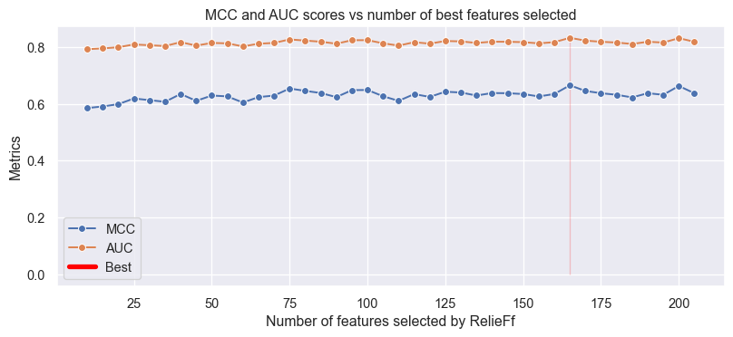
Results | RELIEFF in Ames
Method assumes the dependencies between features and tries to estimate the quality of attributes based on how well the attribute can distinguish between instances that near to each other.
Model with best metrics has
165 features
MLPC | MCC: 0.593, AUC: 0.797, Precision: 0.784, Recall: 0.806, Accuracy: 0.796
SVC | MCC: 0.569, AUC: 0.785, Precision: 0.763, Recall: 0.808, Accuracy: 0.784
RFC | MCC: 0.665, AUC: 0.833, Precision: 0.812, Recall: 0.854, Accuracy: 0.832
DTC | MCC: 0.480, AUC: 0.740, Precision: 0.712, Recall: 0.780, Accuracy: 0.739
XGBC | MCC: 0.632, AUC: 0.816, Precision: 0.799, Recall: 0.831, Accuracy: 0.816
MCC scores with less features
RFC | 30 features: 0.613
RFC | 60 features: 0.605
RFC | 90 features: 0.624
Metrics post hyper parameter optimization
RFC| MCC: 0.641, AUC: 0.820, Prec: 0.796 , Recall: 0.848 , Acc: 0.820

Slide 29
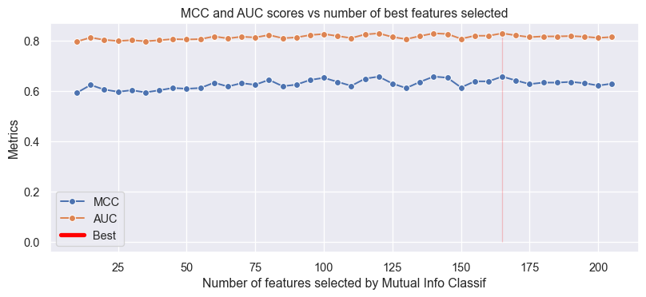
Results | MIC in Ames
Measures mutual information classification between a matrix containing a set of feature vectors and the target. Explains how much information about the target the variable will be obtained by having observed a feature.
Model with best metrics has
165 features
MLPC | MCC: 0.579, AUC: 0.788, Precision: 0.751, Recall: 0.842, Accuracy: 0.787
SVC | MCC: 0.584, AUC: 0.792, Precision: 0.766, Recall: 0.823, Accuracy: 0.791
RFC | MCC: 0.656, AUC: 0.828, Precision: 0.814, Recall: 0.839, Accuracy: 0.828
DTC | MCC: 0.466, AUC: 0.733, Precision: 0.722, Recall: 0.738, Accuracy: 0.733
XGBC | MCC: 0.604, AUC: 0.802, Precision: 0.789, Recall: 0.811, Accuracy: 0.802
MCC scores with less features
RFC | 15 features: 0.623
RFC | 60 features: 0.632
RFC | 95 features: 0.643
Metrics post hyper parameter optimization
RFC| MCC: 0.638, AUC: 0.819, Prec: 0.799 , Recall: 0.839 , Acc: 0.818

Slide 30
Results | Fingerprints in Ames Mutagenicity
We also tried to predict lipophilicity by just using the fingerprints.
Model with best metrics is
SVC
MLPC |MCC: 0.51, AUC: 0.76, Accuracy: 0.74, Precision: 0.78, Recall: 0.76
SVC | MCC: 0.55, AUC: 0.77, Accuracy: 0.76, Precision: 0.78, Recall: 0.77
RFC | MCC: 0.53, AUC: 0.77, Accuracy: 0.74, Precision: 0.80, Recall: 0.76
DTC | MCC: 0.41, AUC: 0.71, Accuracy: 0.68, Precision: 0.74, Recall: 0.70

Slide 31
Results | Ames Mutagenicity
In order to come up with the best model, we tested several configurations that lead us to different results.
Metrics used (RFC) | Baseline | MRMR feature selection | Post hyper-parameter tuning (MRMR) | RelieFf Feature selection | Post hyper-parameter tuning (RelieFf) | Mutual Info Classification Feature selection | Post hyper-parameter tuning (MIC)
# of fts | 207 | 65 | 65 | 165 | 165 | 165 | 165
MCC | 0.632 | 0.648 | 0.643 | 0.665 | 0.641 | 0.656 | 0.638
ACC | 0.816 | 0.824 | 0.823 | 0.833 | 0.820 | 0.828 | 0.819
Metrics used (RFC) | Post manual cleaning | Post Hyper-parameter optimization (PMC) | Fingerprints
MCC | 0.635 | 0.652 | 0.53
AUC | 0.817 | 0.826 | 0.77

Slide 32
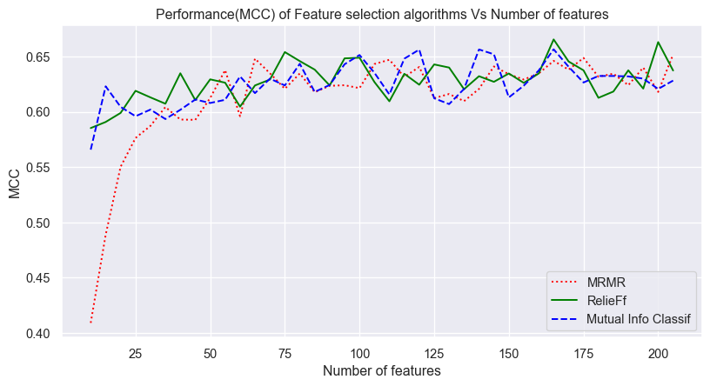
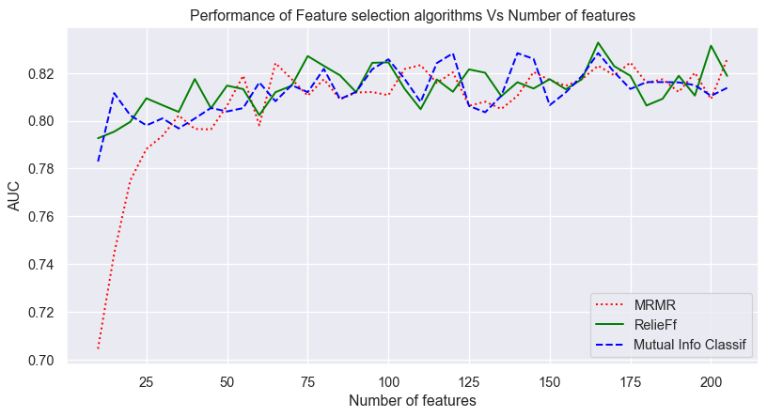
Results | Feature selection performance
Comparative performance of the R2 and MSE scores for all the selected Feature selection algorithms.
Based on these results, we can conclude that the model that better performs is the RFC one with RelieFf selected features and tuned hyperparameters

Slide 33
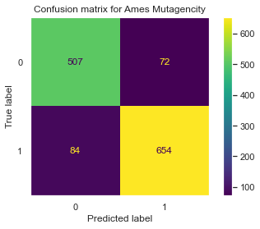
Results | Performance in test set
Now we’ve got the model, we check its performance against the test dataset.
Number of samples: 1317
Metric | MCC | AUC | Accuracy | Precision | Recall
Score | 0.760 | 0.881 | 0.882 | 0.901 | 0.886

Slide 34
Recap | Ames and Lipophilicity
Metrics obtained in each task with the model that better performs, respectively.
Ames mutagenicity - Classification
Lipophilicity - Regression
Scatter plot
Metric | MCC | AUC | Accuracy | Precision | Recall
Score | 0.760 | 0.881 | 0.882 | 0.901 | 0.886
Metric | R2 | MSE | MAE
Score | 0.722 | 0.460 | 0.400
Number of samples: 1317
Number of samples: 840

Slide 35

Conclusions
The project has allowed us to discover the relevance of data science in complex and important processes such as drug discovery.
We have been able to develop a basic understanding of the concepts.
We are now more aware of the impact of different feature selection algorithms on the timing and performance of models.
We are satisfied with both the work we have done and good results we achieved at the end.

Slide 36
Thanks.
Alejandro Corrochano
Azadeh Karimisefat
Dipti Aswal
Yossra Gharbi
In collaboration with Vigneshwari Subramanian and Anton Martinsson from AstraZeneca

